Slide 1
Trash House Example with 5 year old ‘Calvin’
My Three Houses
Theo Klooster

Slide 2
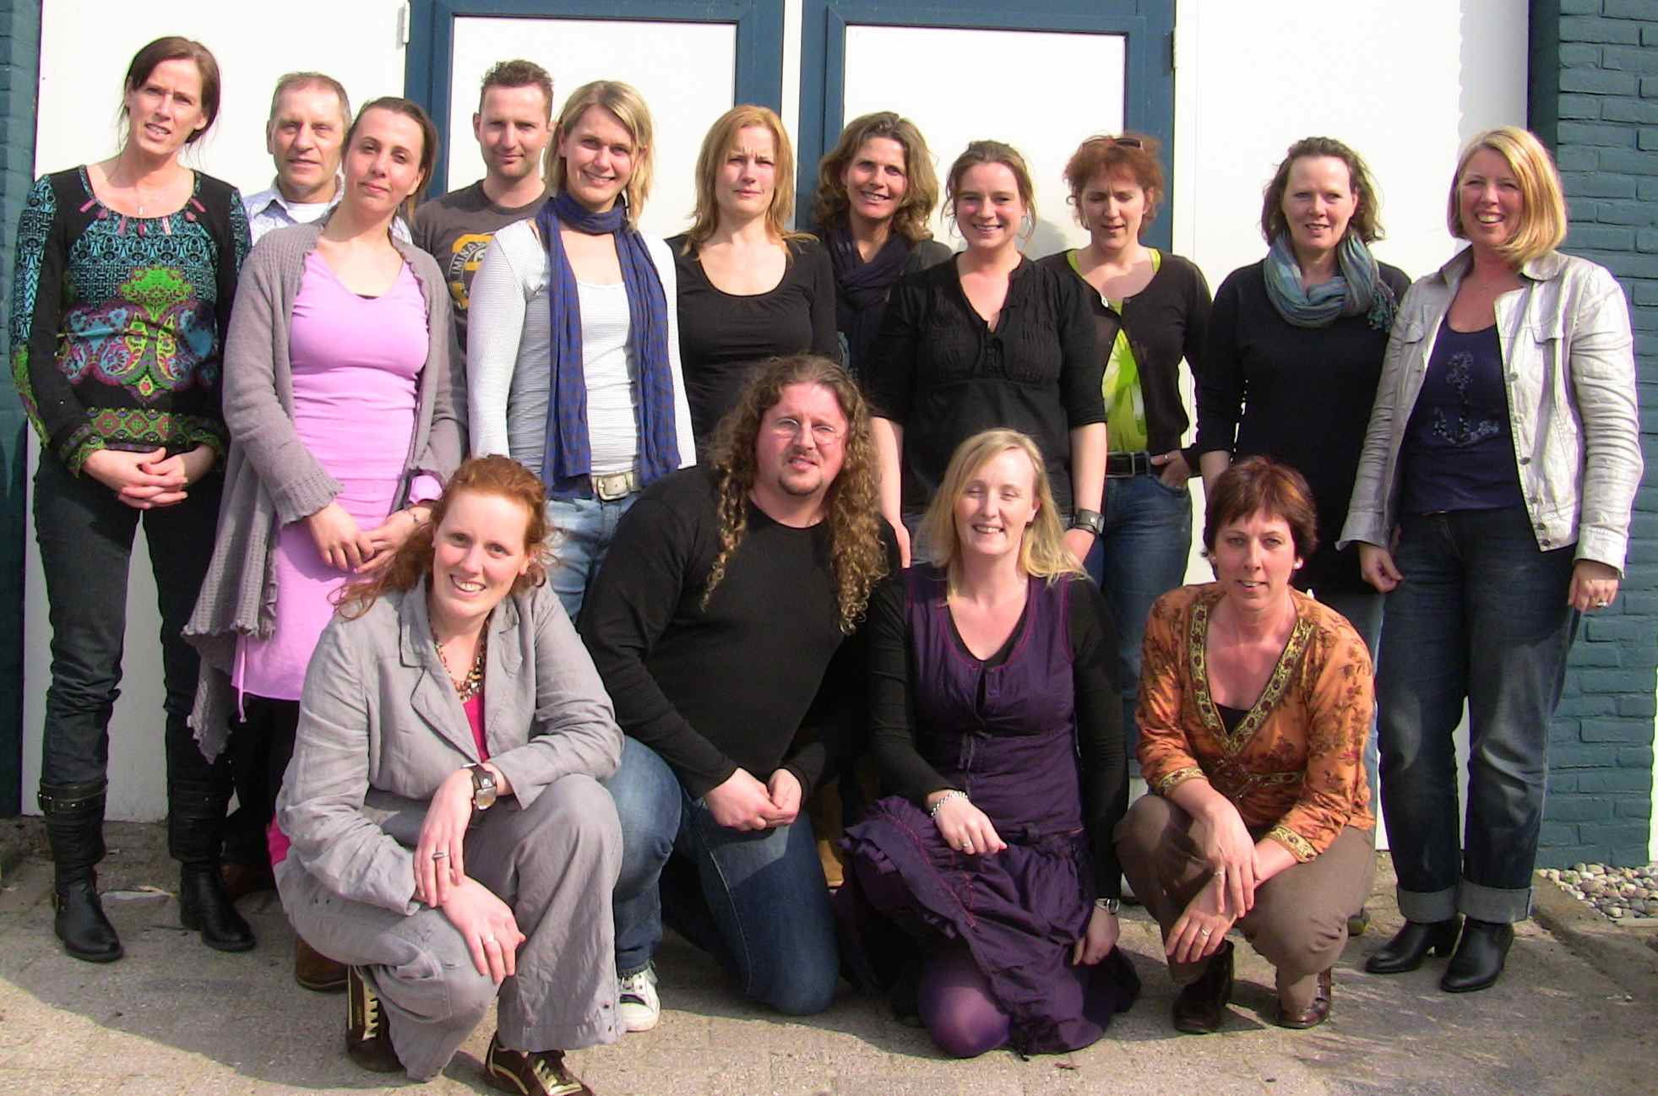
Theo Klooster, Bureau Jeugdzorg Drenthe, Netherlands

Slide 3
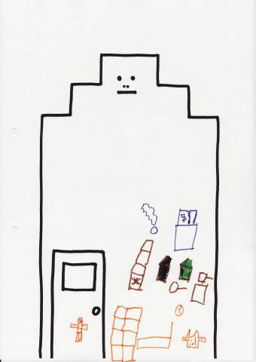
House of Worries:
Mum stays in bed sleeping
Calvin could not get in through the front door, because Mum was in bed
Mum is hospitalised
Many boxes in the house making little room available
Sometimes no clean clothes (cat hair and dust on them)
The freezer contains too much food

Slide 4
House of Worries:
Calvin says he is eating too many pancakes and french fries
Garbage bins are always too full
No fresh air in the house. Calvin says it smells of cat droppings; no nice smells around
Calvin lacks his own bed and cuddle toys

Slide 5
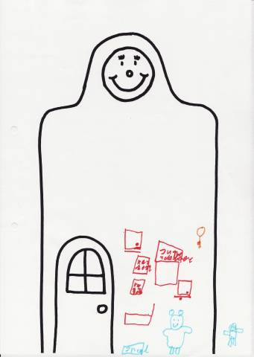
House of Good Things:
His cuddle toys are nice
Calvin has friends to play with outside
Calvin likes to play Monopoly, cards with his Mum, watching TV. The cards Calvin bought with his own money
The computer
Shopping with his Mum

Slide 6
House of Good Things:
His own bed
To have his own key for the front door, so that he can get into the house by himself

Slide 7
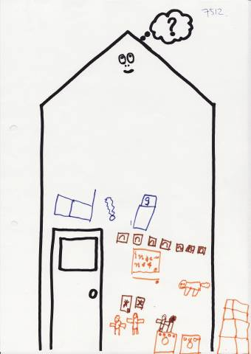
House of Dreams:
Living at home with Mum
Internet on the computer
A tidy house
Clean clothes for Mum and himself
To live with Guerny, the cat (his friend)
Mum making the house tidy

Slide 8
House of Dreams:
More litter trays for the cats
Extra freezer to put all the food in
Calvin wants to visit Mum in the hospital
Mum should not be in bed
Fresh air and a nice smell in the house

